Slide 1
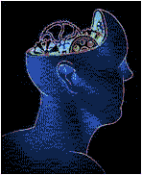


Reproducible Computational Research Why, What, How
Vasant Honavar
Artificial Intelligence Research Laboratory
Computer Science Graduate Program
Bioinformatics and Genomics Graduate Program
Neuroscience Graduate Program
Center for Big Data Analytics and Discovery Informatics
Pennsylvania State University
vhonavar@ist.psu.edu
http://faculty.ist.psu.edu/vhonavar

Slide 2
Research Interests
Machine learning: Statistical, information theoretic, linguistic and structural approaches to machine learning; learning predictive relationships from sequential, graph-structured, multi-relational, multimodal, partially specified, partially labeled, distributed data, linked data
Causal Inference: Causal inference from disparate experimental and observational studies, causal inference from relational data, causal inference from temporal data
Knowledge Representation and Inference: Logical, probabilistic, and decision-theoretic knowledge representation and inference; federated knowledge bases; selective information sharing; federated services; representing and reasoning about qualitative preferences
Applied Informatics
Bioinformatics: Macromolecular structure and function, analysis, inference, modeling, and prediction of macromolecular (protein-protein , protein-RNA, and protein-DNA) interaction networks and interfaces, immune networks, etc.
Health Informatics: Predictive and causal modeling of health outcomes from patient (health records, genomics, socio-economic, environmental) data
Brain Informatics: Modeling and analysis of structure and dynamics of brain networks from fMRI data
Algorithmic Discovery:
Algorithmic abstractions of scientific domains
Representations of scientific artifacts (experiments, data, models, assumptions, hypotheses, theories …)

Slide 3


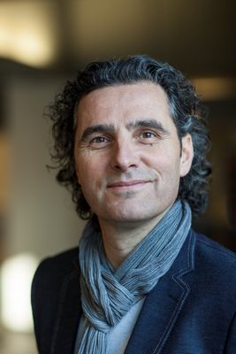





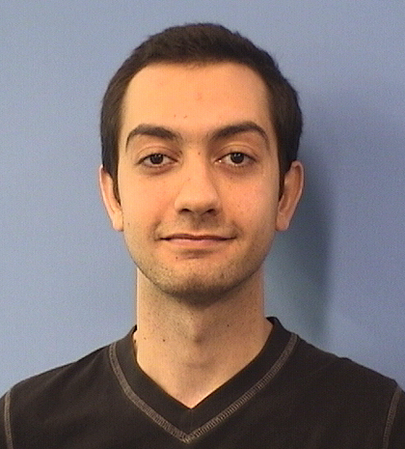








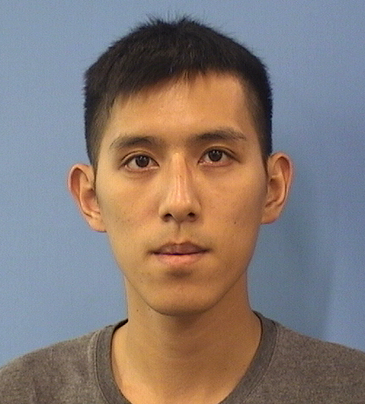


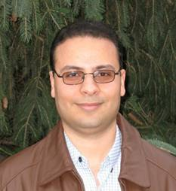
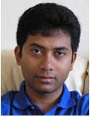






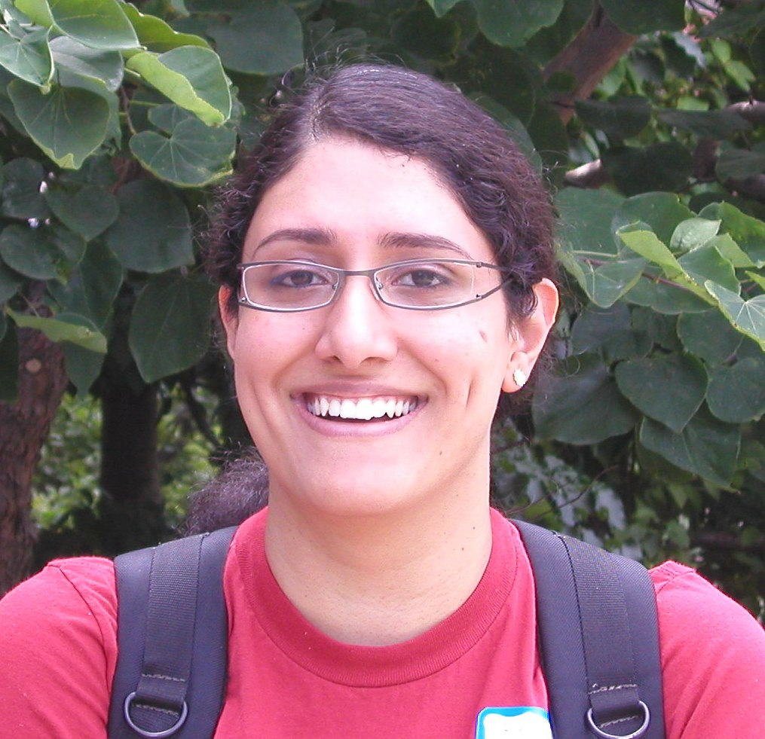




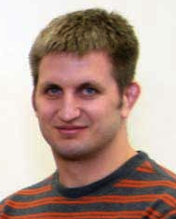





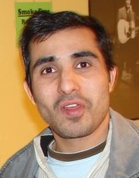

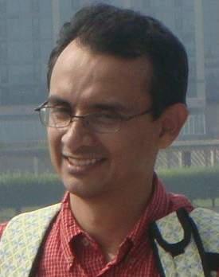
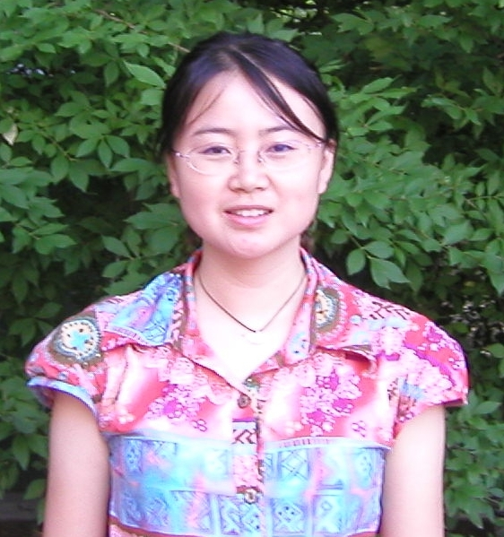
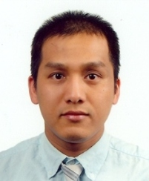
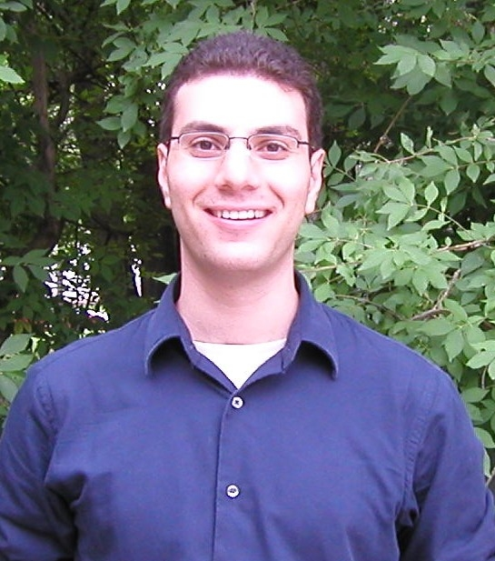


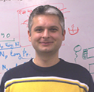



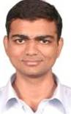


Collaborators
Artificial Intelligence Research Laboratory
Current Ph.D. Students
Recent Ph.D. Graduates (2005 – 2017)

Slide 4
First: A story from the trenches
Andorf, Carson, Drena Dobbs, and Vasant Honavar. "Exploring inconsistencies in genome-wide protein function annotations: a machine learning approach." BMC bioinformatics 8.1 (2007): 284.

Slide 5
Protein annotation using machine learning: Background
Exponential increase in protein sequences
Experimental determination of structure and function lags behind
Automated methods for protein function annotation
Allow high-throughput annotation of thousands of sequences
Increase the risk of error propagation
Potential sources of errors
noisy training data
error in the algorithm
mislabeled data
poor performance of algorithm
simple clerical errors
human error

Slide 6
Focus: Protein Kinases
Protein Kinases are among
The most well-studied proteins
The most popular drug targets
Two broad classes (some have dual specificity)
Serine/Threonine kinases
Tyrosene kinases
Protein serine/threonine phosphorylation regulates virtually every signaling pathway in the eukaryotic cell
Tyrosine phosphorylation modulates key biological events associated with development and disease
cancer, diabetes, and inflammation
Accurate annotation extremely important

Slide 7
Data set: Human and Mouse Protein Kinases
Gene ontology annotations (www.geneontology.org)
GO:0003674 : molecular_function ( 121801 )
- GO:0003824 : catalytic activity ( 41632 )
- GO:0016740 : transferase activity ( 13210 )
- GO:0016301 : kinase activity ( 5613 )
- GO:0004672 : protein kinase activity ( 3415 )
- GO:0004674 : protein serine/threonine kinase activity ( 2077 )
- GO:0004713 : protein-tyrosine kinase activity ( 771 )
Data retrieved in 2007 [Andorf et al., BMC Bioinformatics, 2007]

Slide 8
Data set: Human and Mouse Protein Kinases
Initial goal: predicting protein kinase subclasses using machine learning
Machine learning algorithms
Naïve Bayes: Amino acid composition
NB(k): Extension of Naïve Bayes to kth order Markov model
SVMs using these data representations
A hybrid algorithm that combines the above with annotation transfer based on sequence homology (BLAST)
Initial Question: how effective are these methods on classifying kinases?

Slide 9
Experiment 1
Data: 244 mouse and 330 human protein sequences
GO families GO0004674 (Serine/Threonine Kinase)
GO0004713 (Tyrosine Kinase)
Reference class labels: annotations returned by AmiGO
71 mouse and 233 human proteins are labeled with GO0004674
106 mouse and 90 human proteins are labeled with GO0004713
67 mouse and 7 human proteins had both labels
Train classifier on human data and test on human data
Train classifier on human data and test on mouse data

Slide 10
Experiment 1: Results
Classifier trained on human data and tested on human data (cross validation)
89.1% accuracy with a 0.85 correlation coefficient
Good! ☺
Classifier trained on human data and tested on mouse data
15.1% accuracy and a -0.42 correlation coefficient
Bad! ☹
Result surprising because
Human and mouse kinases share common origin (homologues)
Question: How can we explain these results?

Slide 11

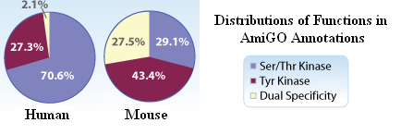
First observation: Discrepancy in Distribution

Slide 12
Second Observation: Evidence codes
211 of the 244 mouse protein kinases had a RCA (inferred from reviewed computational analysis) evidence code
Of the 33 mouse proteins that did not have a RCA evidence code, 28 were classified correctly by the classifier trained on human data
Question: What is special about the 211 mouse proteins with GO function labels with RCA evidence code?

Slide 13
Third Observation: Source of RCA annotations
Annotations returned by AmiGO came from the Mouse Genome Informatics Database (MGI)
The MGI annotations came from the Fantom2 (Functional Annotation of Mouse) Database
Each of the 211 mouse proteins had at least one RCA from FANTOM Consortium and the RIKEN Genome Exploration Research Group (Okazaki et al, Nature, 420, 563-573, 2002)
Are there other independent annotations for these proteins?
Fortunately Yes - UniProt

Slide 14
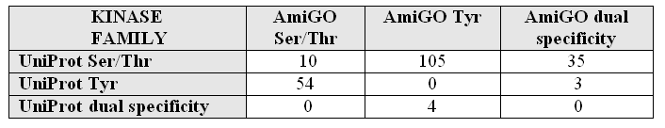
Fourth Observation: Inconsistency between UniProt and AmiGO
AmiGO RCA annotations for 201 of the 211 mouse proteins were inconsistent with UniProt annotations
A search of the Mouse Kinome Database shows that 154 of the 244 mouse kinases have a human ortholog with sequence similarity greater then 90%!
Why does machine learning fail on this problem?

Slide 15
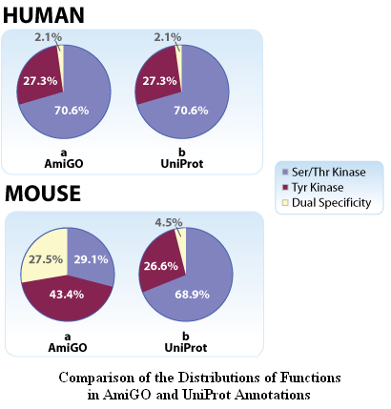
Fifth Observation: Distribution of Annotations

Slide 16
Story so far
When reference annotations are from AmiGO:
Classifier trained on human kinases and tested on human kinases – good
Classifier trained on human kinases and tested on mouse kinases – bad
AmiGO RCA and UniProt annotations inconsistent
Questions:
Could the AmiGO RCA annotations be incorrect?
How does the classifier trained on human and tested on mouse perform when the reference annotations are from UniProt?

Slide 17
Experiment II
Use UniProt labels instead of AmiGO labels as reference
Train classifier using Human proteins and test on mouse proteins
Test accuracy on mouse proteins: 97%!
205 of the 211 proteins that were mislabeled with respect to AmiGO reference labels were correctly labeled with respect to UniProt reference labels

Slide 18
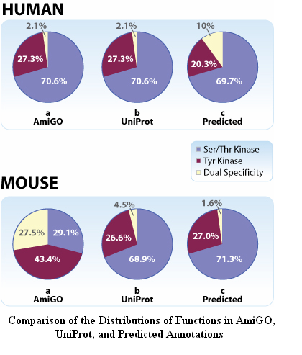
Sixth Observation: Distribution of Annotations

Slide 19
Tentative Conclusions
There is no reason to expect that the relative distribution of the Ser/Thr kinsases and Tyr kinases in human and mouse would be dissimilar
The machine learning approach used is sound, and found effective in other macromolecular sequence classification tasks
Could it be the case that the annotations returned by AmiGO for the 211 mouse protein kinases (nearly 95% of the 244 mouse protein kinases) are incorrect?

Slide 20
Following up
To the best of our knowledge, the problematic mouse kinase annotations with RCA evidence code
Came from Okazaki et al, Nature, 420, 563-573, 2002
Were propagated to MGI through the Fantom2 (Functional Annotation of Mouse) Database
And from MGI to AmiGO
Examination of GO annotation is often the first step in many high throughput studies e.g., gene expression analysis
Question: How far did these annotations propagate?

Slide 21
Following up
136 rat protein kinase annotations from AmiGO had:
ISS - inferred based on sequence or structural similarity- evidence code
Functions assigned based on some of the 201 potentially incorrectly annotated mouse proteins
94 Ser/Thr kinase proteins mislabeled as either a Tyr kinase or dual specific
42 Tyr kinase proteins mislabeled as a Ser/Thr kinase or a dual specific
201 mouse and 136 rat protein kinase annotations are probably incorrect!
Not to mention annotations of other kinases and analyses that relied on these erroneous annotations!

Slide 22
Conclusions: Detecting Annotation Errors Using Machine Learning
The apparent failure of a machine learning approach helped us discover potential errors in annotations
Our discovery further underscores the need for better procedures for
Multiple checks for consistency of annotations – especially in the case of annotations with RCA and ISS evidence codes
Better methods for tracking propagation of annotations across databases
Reproducible (and correctible) computational workflows
The erroneous mouse kinase annotations were traced to errors in annotation scripts used and have since been fixed by the MGI ☺

Slide 24
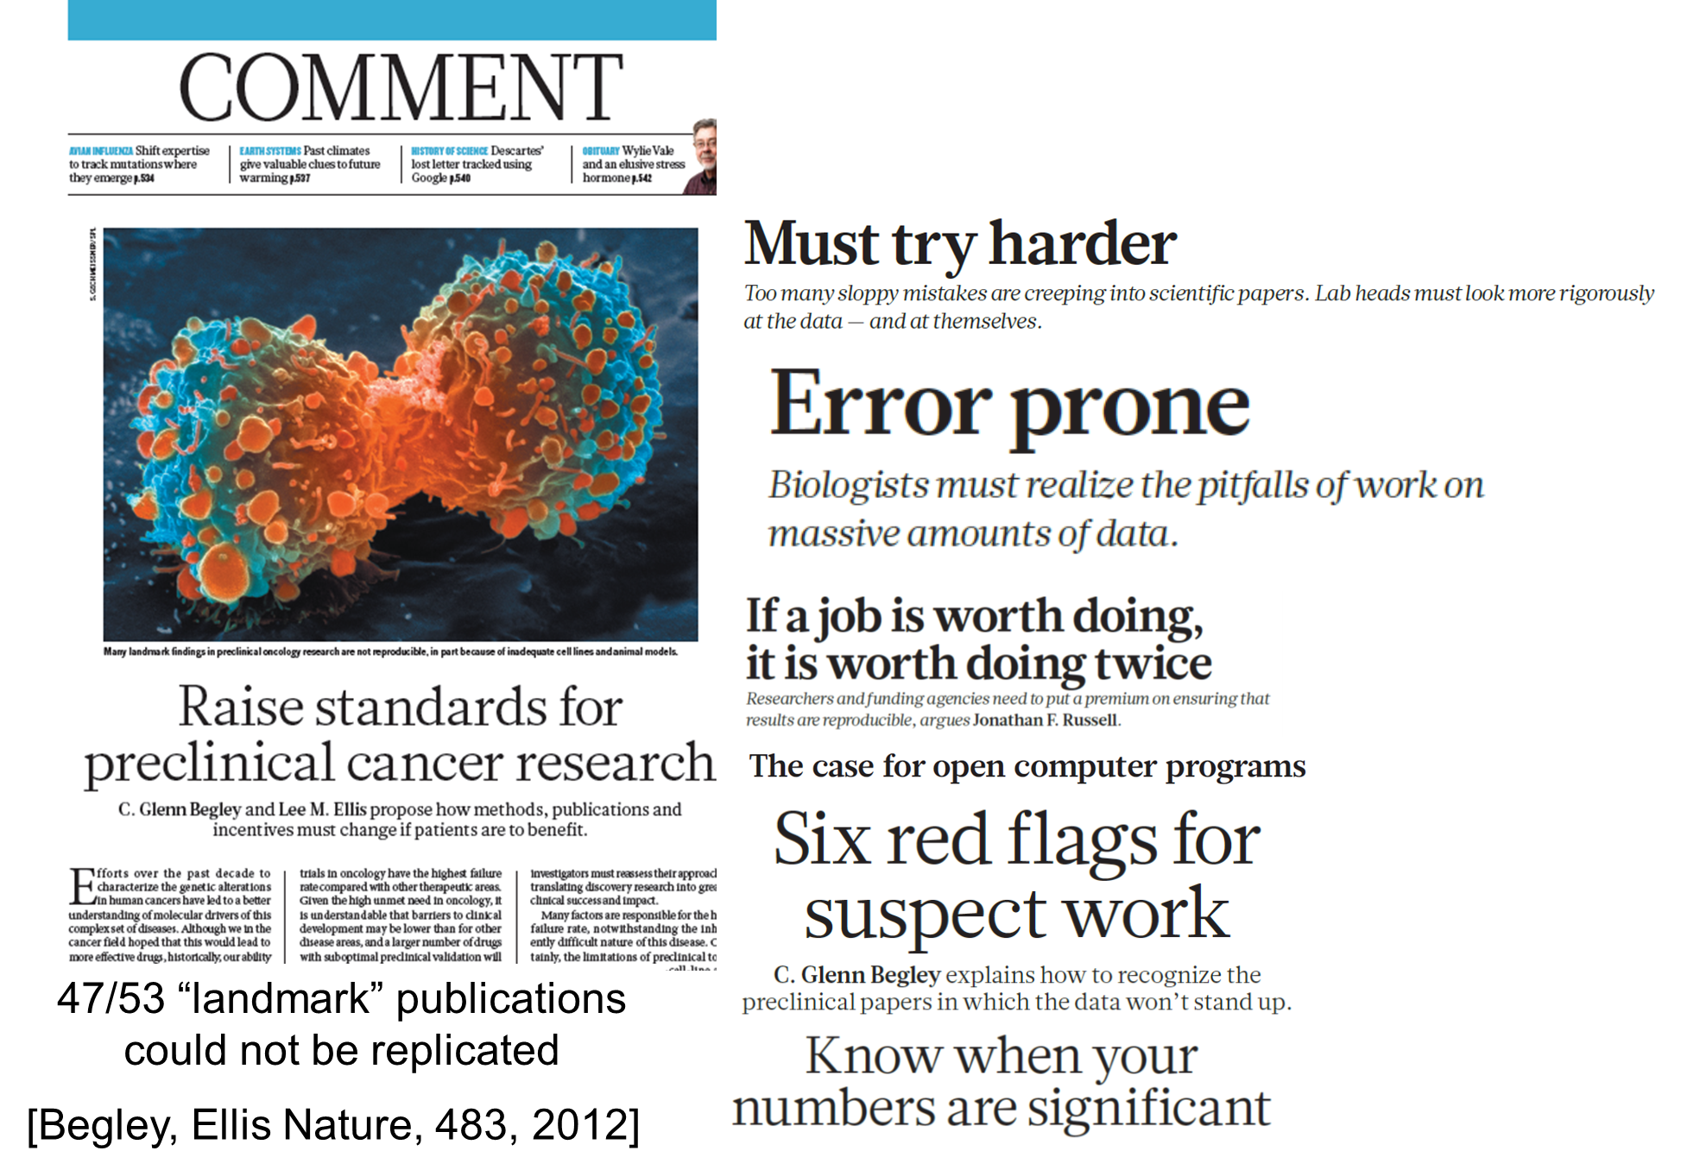
Reproducibility crisis

Slide 25
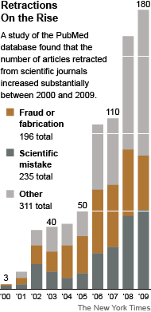
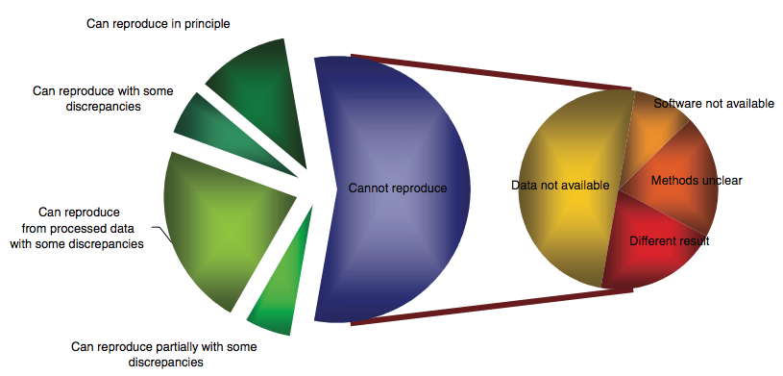
Reproducibility crisis
More retractions:
>15x increase in the last 10 years
At current rate, by 2045 as many papers published as retracted

Slide 26
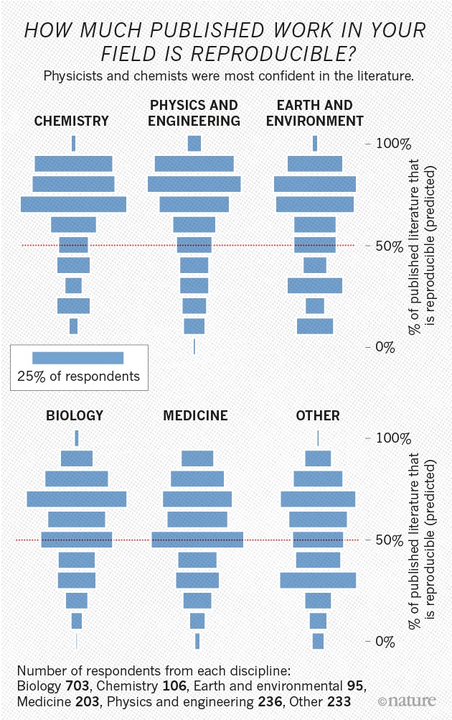
*
Baker, M. (2016). 1,500 scientists lift the lid on reproducibility. Nature,533(7604), 452-454.

Slide 27
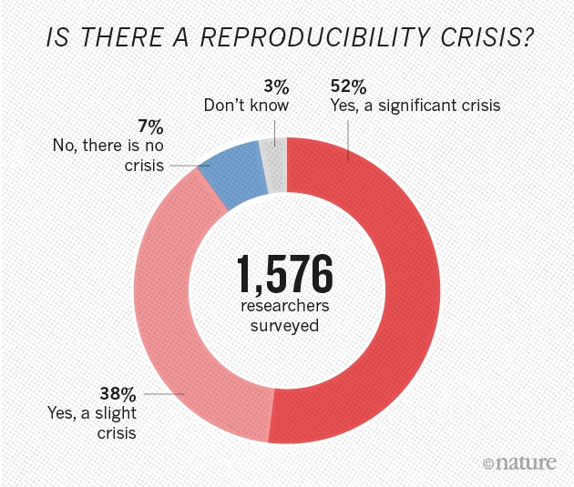
*
Baker, M. (2016). 1,500 scientists lift the lid on reproducibility. Nature,533(7604), 452-454.

Slide 28
On scientific practice
Science is the systematic enterprise of gathering knowledge about the universe and organizing and condensing that knowledge into testable laws and theories.
The success and credibility of science are anchored in the willingness of scientists independent testing and replication by other scientists. This requires the complete and open exchange of data, procedures and materials.

Slide 29
Scientific method
Empirically testable
Replicable
Objective
Transparent
Falsifiable
Logically consistent

Slide 30
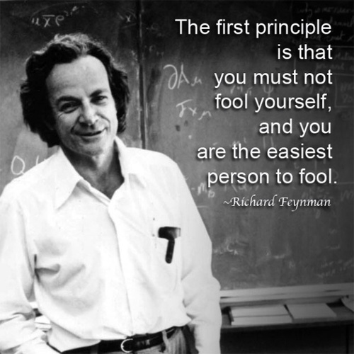
On scientific practice

Slide 31
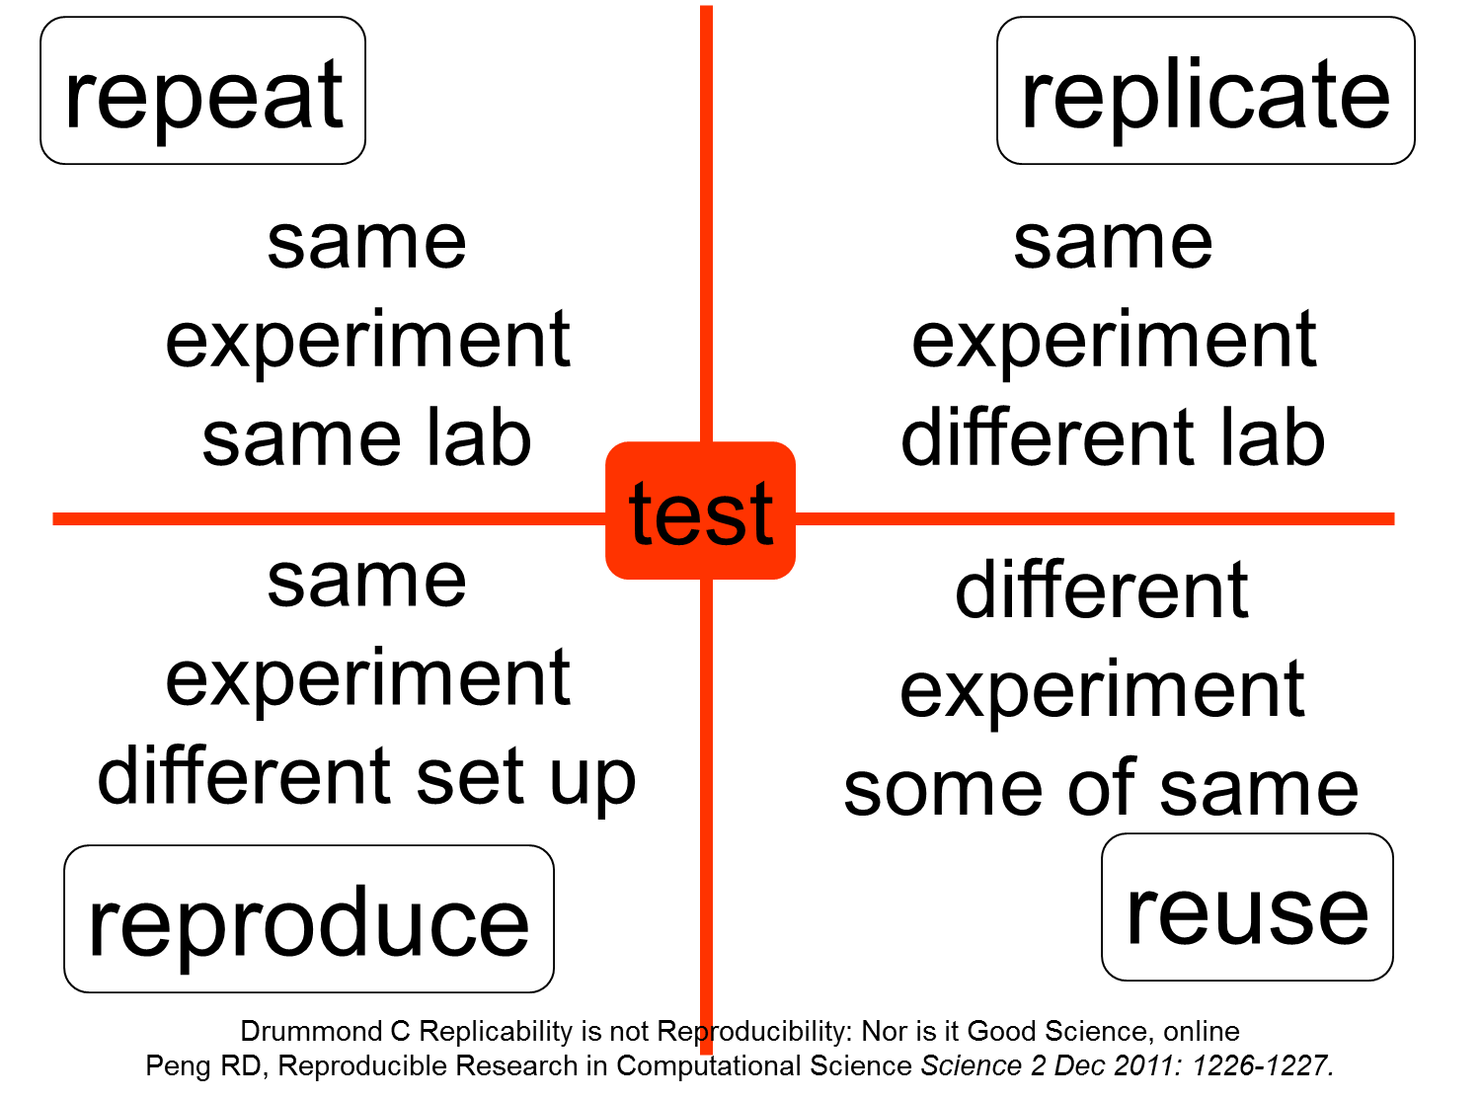
Pillars of the scientific method

Slide 32
Pillars of the scientific method
Replication – independent researchers going out and collecting new data to verify scientific findings – considered the scientific gold standard.
Reproduction – independent researchers analyze the same data and produce the same result. Focus on transparency of data analysis.
Peng, Roger D. (2011) “Reproducible Research in Computational Science.” Science 334.6060: 1226–1227.

Slide 33
Many dimensions
Samples
Measurements
Experiment design
Data
Statistical considerations
Analysis
Scientific misconduct

Slide 34
Science as we know it
Reproduction, Reuse, Synthesis, Integration
Review, Replication, Communication, Publication
Model
Abduction
Hypotheses
Background
Knowledge
Induction
Deduction
Data
Predictions
Observation
Experimentation

Slide 35
Traditional scientific research cycle
Design Experiment
Complications
Form
Hypothesis
Collect Data
Technological advances:
Huge, complex digital datasets
Computational power
Ability to share
Human Error:
Poor Reporting
Flawed analyses
Publish research
Analyze Data
Write manuscript

Slide 36
Modern scientific research cycle
Design Experiment
Form
Hypothesis
Plan for data storage
Publish research
Collect Data
Share data
Write manuscript
Clean Data
Curate data
Analyze Data

Slide 37
Reproducible scientific research cycle
Plan for data
storage
Data
Management
Plans
Form
Hypothesis
Design Experiment
Unique
Identifiers
Reproducible
Research
Collect Data
Electronic Data Capture
Publish research
Share data
Write manuscript
Clean Data
Metadata
Reproducible reporting
Repositories
Version control
Curate data
Analyze Data

Slide 38
Reproducible Research: Relation to scientific method
Steps of a scientific method:
Define a question
Form an explanatory hypothesis
Test the hypothesis by performing an experiment and collecting data in a reproducible manner
Analyze the data
Interpret the data and draw a conclusion
Publish results
Validate (reproduce) against the findings of other researchers
Crawford S, Stucki L (1990), "Peer review and the changing research record", "J Am Soc Info Science", vol. 41, pp. 223–228
The steps related to the Reproducible Research are in red

Slide 39
Reproducible Computational Research
Reproducible Research (RR) aims to complement scientific articles with everything required to independently reproduce the results described therein:
Everything includes:
Experimental design
Data
Analysis workflow
Computer codes
A precise description of how the code was applied to the data (parameter choices etc.)
Delescluse, Matthieu, et al. "Making neurophysiological data analysis reproducible: Why and how?" Journal of Physiology-Paris 106.3 (2012):159-170.
Notes:
IEEE members are still changing the world we live in.

Slide 40
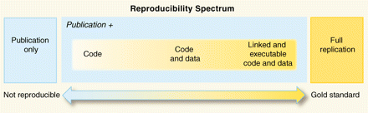
Reproducibility Spectrum
“The published paper is only an advertisement of the scholarship; it is not the scholarship itself. The actual scholarship is the complete software development environment and the complete set of instructions which generated the figures.”
Jonathan Buckheit and David Donoho, paraphrasing Jon Claerbout
*
Peng, Roger D. (2011) “Reproducible Research in Computational Science.” Science 334.6060: 1226–1227.

Slide 41
Basic criteria for reproducibility
A study is reproducible if
The experiment design is fully described
The data are made available
The statistical methods are fully described and computer code is made available
Documentation for both data and methods made available; and
Standard methods of distribution are employed.
Reproducibility is especially important for studies that have low probability of full replication within the relevant timeframe for a variety of reasons

Slide 42
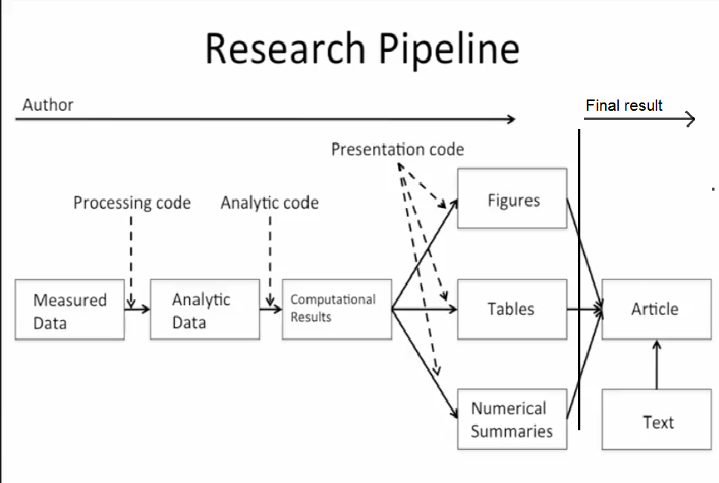
Reproducible research pipeline
*
Source: http://www.biostat.jhsph.edu/~rpeng/research.html

Slide 43
Challenges to reproducibility
High throughput measurement technologies
Emergence of big data
Secondary use of research data in contexts other than originally intended
Integrative analyses of disparate data of uncertain quality and provenance
Tools of uncertain quality
Low Signal-to-noise
Hyper-competitive research environment

Slide 44
Reproducibility crisis: A computational perspective
Reluctance to make data available
Poor documentation of data
Effort needed to regenerate data from description provided
Lack of automation (e.g., interactive use of excel spreadsheets in data analysis)
Poor scientific practices
Incomplete description of key steps (e.g., for generating a plot)
data dredging (p hacking)
failure to report negative finding
inclusion/exclusion of samples to obtain a desired conclusion ….

Slide 45
Reproducibility crisis: A computational perspective
Lack of availability of code:
Lack of transparency
Reluctance to make codes public
Additional time and efforts to improve code quality, documentation, etc.
Poor software engineering skills
Poor quality code
Errors
Poor software engineering practices
Poor coding style
Poor documentation

Slide 46
Reproducibility crisis: A computational perspective
Poorly described data processing steps
Normalization
Feature engineering
Feature selection
Dimensionality reduction
Poorly described computational experiments
Lack of details about user specified parameters
Random number used
Training and test sets
Performance measures

Slide 47
Reproducibility crisis: A computational perspective
Infrastructure
Data resources
Computational resources
Dependence on libraries
Dependence on Operating System
Dependence on system conditions (load, etc.)

Slide 48
Current status: Reproducible research in machine learning
Increasing availability of benchmark data
Comparison of a new machine learning method against competing methods mandatory
Publication of code increasingly mandatory
Increasing automation of computational experiments
Increasing pressure on authors for transparency (parameter tuning, data pre-processing, etc.)

Slide 49
Current status: Reproducible research in biostatistics
Authors should provide all data code in order to reproduce all results, images and tables with:
README file
Consistent coding style and documentation
Test data sets
Simulations and random numbers
General advice
Peng, R. D. (2009). Reproducible research and biostatistics. Biostatistics,10(3), 405-408.

Slide 50
Reproducibility delayed is reproducibility denied
Making a research project reproducible at the completion of the project, just as documenting software after you are done writing code, is not the best way
Document everything as you go
This means
Data
Experimental details
Code
Preprocessing steps
Parameters
….

Slide 51
Reproducible computational research: Personal incentives
Published findings can be verified
Alternative analyses conducted
Challenge uninformed criticisms (“put up or shut up”)
Expedite exchange of ideas among investigators
Better visibility of research
More citations and higher impact
Increased trust in research quality (outside academia, e.g., industry, public)
Engaging the broader community in improving data, methods, tools… (analogous to open source software)

Slide 52
Reproducible computational research: Tools
Recommended programs to use to achieve
reproducibility:
Latex (Tex editor)
Version control systems - Git software systems
Make – pipeline
Literate programming concept (Knuth).

Slide 53
Reproducible computational research: Tools
Matlab not recommended
Proprietary toolboxes
Open source alternatives
Octave
Scilab
Sagemath

Slide 54
Reproducible computational research: Tools
R programming language:
R studio – development environment for R programming language
Graphic packages, such as ggplot2
Packages as knitr or rmarkdown – literate programming support

Slide 55
Reproducible computational research: Tools
Python programming language:
Many open scientific libraries available – scipy, numpy, etc.
IPython notebook
Sumatra package – save parameter values, code state, output results and files

Slide 56
Reproducible computational research: Tools
Data and metadata
Data ingestion
Data cleaning
Data integration
Analysis 1
Analysis 2
Output generation
Data and metadata
Data ingestion
Data cleaning
Data, visualizations, and metadata
false
Data and metadata
Predefined process
(subroutine)
Data ingestion
Data cleaning
IF
true

Slide 57
Reproducible computational research: Tools
Computational workflows in which
Each step can be implemented using programming language of one’s choice
The inputs and parameters of each step are formally recorded
Each step can be executed on appropriate computational platform
It is possible to reuse of individual steps as well as the overall workflow
Notes:
Formal Scientific workflow systems are now in development to help scientists document their workflows. These analytical pipelines will make it possible for lay scientists to use workflows effectively for documenting their process metadata.
Each step within the scientific workflow system can be implemented using different software systems. In the process of performing analyses, each step and its parameters and requirements are formally recorded. This allows both the individual steps and the overall workflow to be reused, either by the original scientist or someone else.

Slide 58
Reproducible computational research: Tools
Workflows provide
Abstraction and encapsulation
Ease of use
Single access point for multiple analyses
Reproducibility
Reuse and adaptation
Documentation
Training
Notes:
There are many benefits of using scientific workflows.
First, they can provide a single access point for multiple analyses across software packages.
Second they allow a researcher to keep track of analyses conducted, which enables reproducibility.
Third, workflows can be stored as documentation of the research project. A stored workflow is essentially higher-level metadata which offers tremendous potential for scientific advancement.
Finally, workflows allow researchers to share and reuse the workflow or its components. This means less time doing repetitive tasks, allows for collaboration across disciplines, and rapid analysis since time is not spent “reinventing the wheel”.

Slide 59
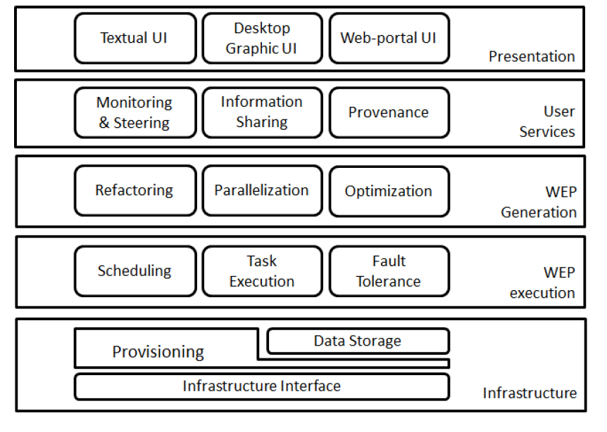
Scientific Workflow Management Systems

Slide 60
Reproducible computational research: Tools
Several mature scientific workflow systems available:
Kepler (built on top of Ptolemy)
Pegasus
Taverna
Galaxy (initially focused on genomics)
and many more….

Slide 61
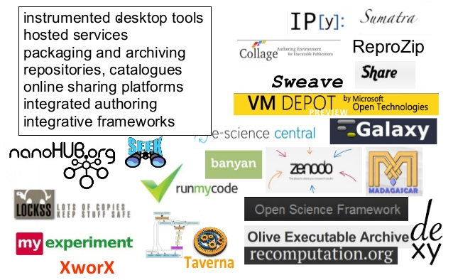
Reproducible computational research: Tools
*

Slide 62
Reproducible Computational Research: Resources
Courses:
Data science specialization (www.coursera.org) (John Hopkins University) – course 5 Reproducible research
Research Methods: An Engineering Approach (www.edx.org) (Wits University )
Research Data Management and Sharing (www.coursera.org) (The University of North Carolina at Chapel Hill & The University of Edinburgh)

Slide 63
Reproducible Computational Research: Resources
Software tools for RR:
Software carpentry (www.Software-carpentry.org) – basic computing skills for researchers
Bootcamps - one or two day long courses – teaching coding and professional skills for researchers – like the one that you are attending
Courses - www.coursera.org, www.edx.org, www.udacity.org - for programming skills in R, Python, etc.

Slide 64
Reproducible Computational Research: Resources
Books:
Stodden, V., Leisch, F., & Peng, R. D. (Eds.) (2014). Implementing Reproducible Research. CRC Press
Gandrud, C. (2013). Reproducible Research with R and R Studio. CRC Press
Subramanian, G. (2015). Python Data Science Cookbook. Packt Publishing Ltd.

Slide 65
Thank you!

